Slide 1
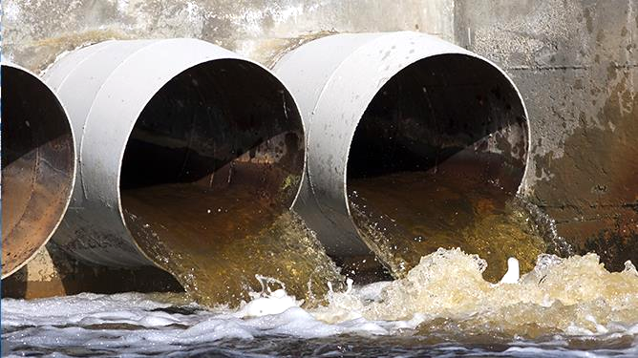
Investigating drug usage across European countries as a factor of age and GDP using wastewater metabolite data
Trevor Pettit, Scout Thompson, Jake Simanek & Peter Baker
Notes:
-introduce our group
-our investigation used 3 data sources to investigate a population’s age and GDP as factors of drug consumption

Slide 2
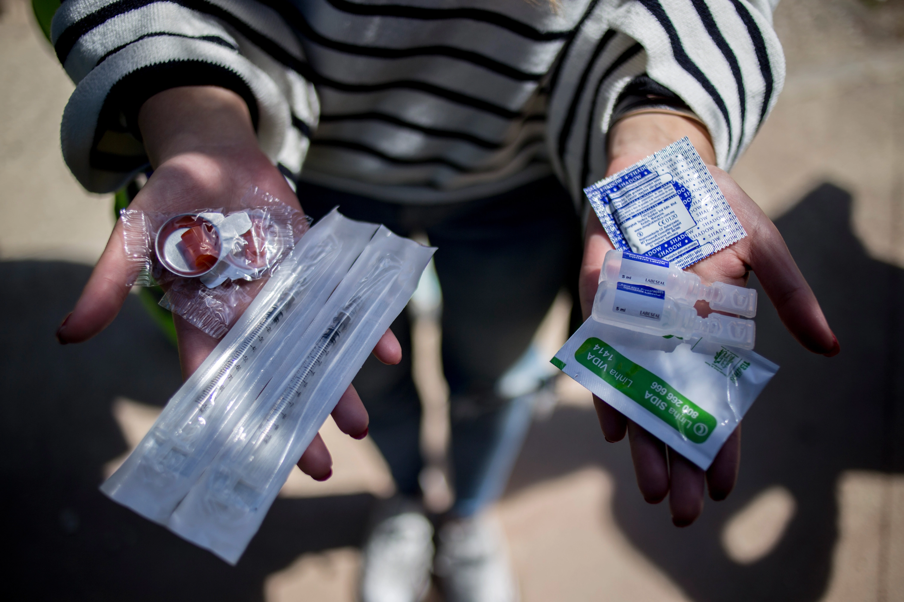
Introduction
Substance abuse: The usage of drugs and other substances despite negative long-term effects
Problematic usage is more often a reflection of societal problems rather than of individuals
The ability to reliably forecast drug usage trends may allow for early intervention
Notes:
-Ingestion of substances with the intention of producing an altered mental state is a universal human behavior and can be done in a way that promotes positive personal and social experiences
-It is therefore important to state that not all substance use results in negative long-term effects
-Substance abuse is characterized by drug use despite negative consequences to social, mental, physical, and financial wellbeing
-This disorder can be a symptom of underlying psychological and-or physical distress and indeed a reflection of broader systemic dysfunction
-Therefor, our investigation proceeds on the assumption that trends in large-scale problematic use is not reflective of individuals, but the society they live in
-If proxy indicators exist that would allow public health officials to reliably forecast drug use trends, they could be better poised to address the issue

Slide 3
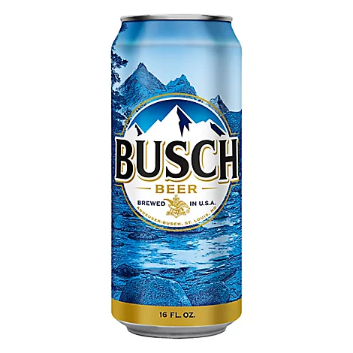
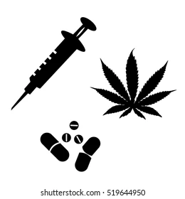
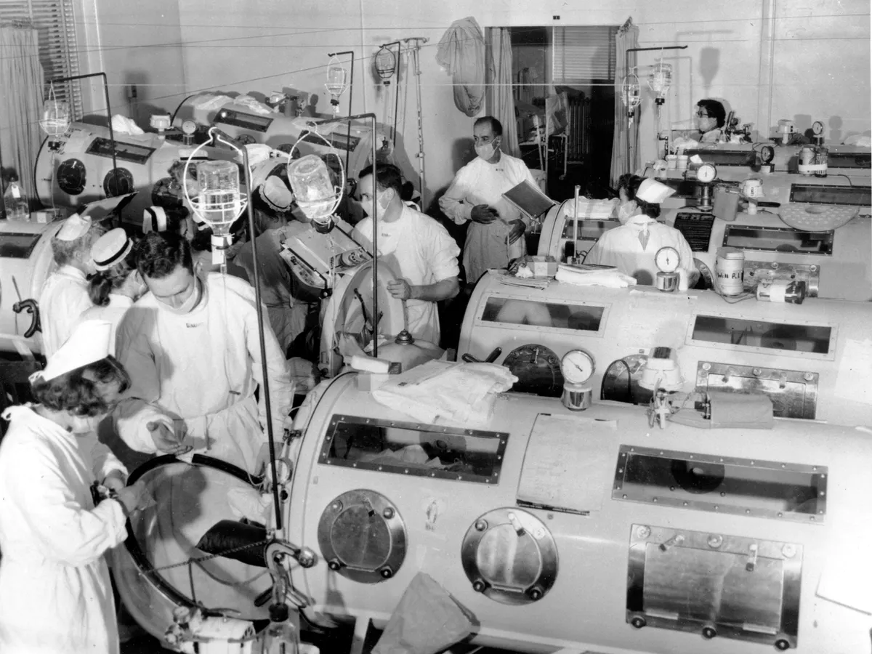


Wastewater analysis
A technique used to determine the consumption of, or exposure to chemicals and/or pathogens in a population. Performed by measuring levels of chemicals and/or biomarkers found within the municipal wastewater.
Polio outbreak, 1940s
Notes:
Modern plumbing provides a unique opportunity for study
Wastewater has a known origin, destination, rate of cycling, and services a known populous
The scale of waste management infrastructure allows researchers to survey large populations without requiring direct participation
This technique was leveraged by researchers during the polio outbreak to test the efficacy of vaccination in a Connecticut city
This style of analysis has since been applied to detect eutrophing agents, environmental contaminants, and more recently, the presence of Covid
When applied to public health inquiries, this methodology is termed “wastewater based epidemiology”
Wastewater data account for response bias by indiscriminately collecting wastewater from a given locality.
It also provides high resolution temporal data since these measurements can be made daily
In these ways it has advantages over traditional data collection techniques
Surveys, for example, take much longer to conduct, do not sample an entire population, rather a subset, and are prone to response bias
WWA is broad in the sense that only the averages for a population can be gleaned and will not reveal the true distribution of drug use for individuals within in a population.
However, given the scale, consistency, and reliability of the method, these wastewater data can be paired with other demographic data for multiple locations to tease out potential factors affecting drug consumption

Slide 4


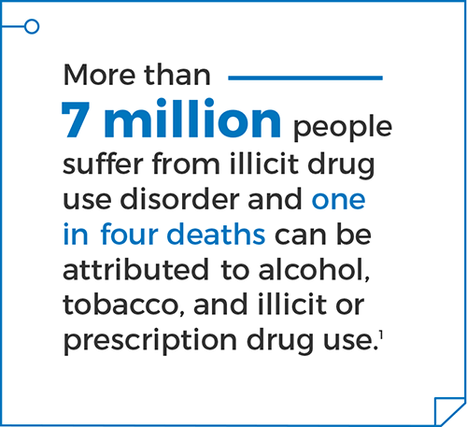
Why do we care about drug levels?
Weakened immune system
Heart & lung disease
Seizures
Stroke
Brain damage
Memory loss
Risk of psychiatric disorders
Loss of relationships
Trauma
Environmental impact
Crime
Financial instability
Abuse
Disease exposure
Enabling use
https://www.samhsa.gov/data/sites/default/files/NSDUH-FFR1-2015/NSDUH-FFR1-2015/NSDUH-FFR1-2015.htm
Addiction hurts everyone.
Notes:
-Substance abuse describes a breadth of behavior that manifests in many different ways with variations in drug(s) used, their quantity, frequency, demographics affected, and health risks incurred
-physical health impacts can be transient to permanent, and increase burden on community healthcare and emergency response
-individual instability in physical, emotional, and financial health reduces positive community engagement
-On a large scale, substance abuse challenges the cooperative social mechanisms that promote a sense of belonging and well-being
-it is important to have a pulse on a communities drug use to improve response time from public health outlets
-it is often the case that substance use only becomes apparent after significant tragedy, such as the current opioid epidemic
-physical addiction can further complicate public health intervention by decoupling use from the environmental triggers that initiated use, another reason that real-time monitoring is a powerful tool

Slide 5

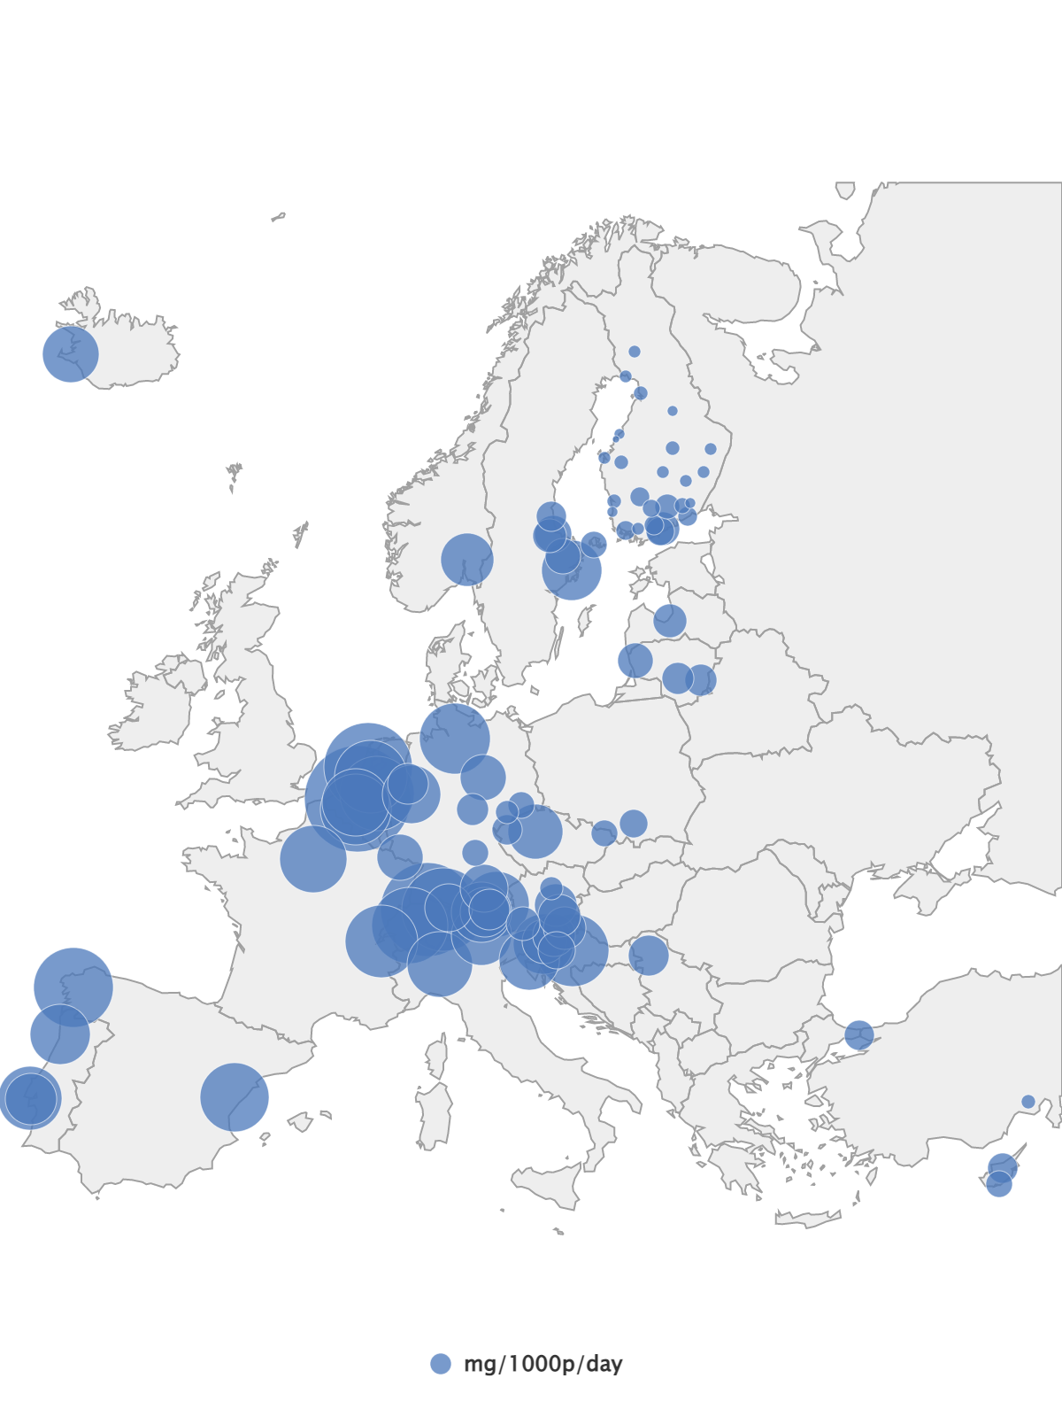
Wastewater data acquisition
Figure 2: relative geographical distribution of cocaine metabolite as detected in European cities, 2020 (daily mean)
This EMCDDA is committed to supporting European policy-making by providing evidence-based information on drugs, their use, and consequences.
An ongoing wastewater based epidemiological study since 2011
The study sites include municipal wastewater treatment facilities from 137 cities across 29 European Countries
Notes:
Our study built upon data acquired from the European Monitoring Center for Drugs and Drug Addiction (EMCDDA).
This organization is committed to supporting European policy-making by providing evidence-based information on drugs, their use, and consequences.
The organization has been conducting an ongoing large-scale wastewater based epidemiological (WBE) study since 2011.
It was this study where we sourced our data for population estimates of drug consumption.
The EMCDDA investigation involves sampling wastewater from municipal wastewater treatment facilities multiple times per week from 137 cities in 29 European countries.
These water samples are analyzed for the presence of five common illicit drugs (Cannabis, Cocaine, Amphetamines, Methamphetamine, and MDMA).

Slide 6

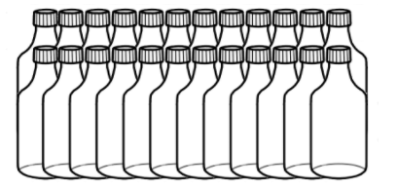



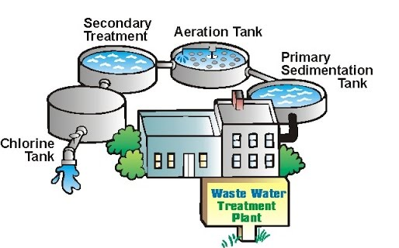

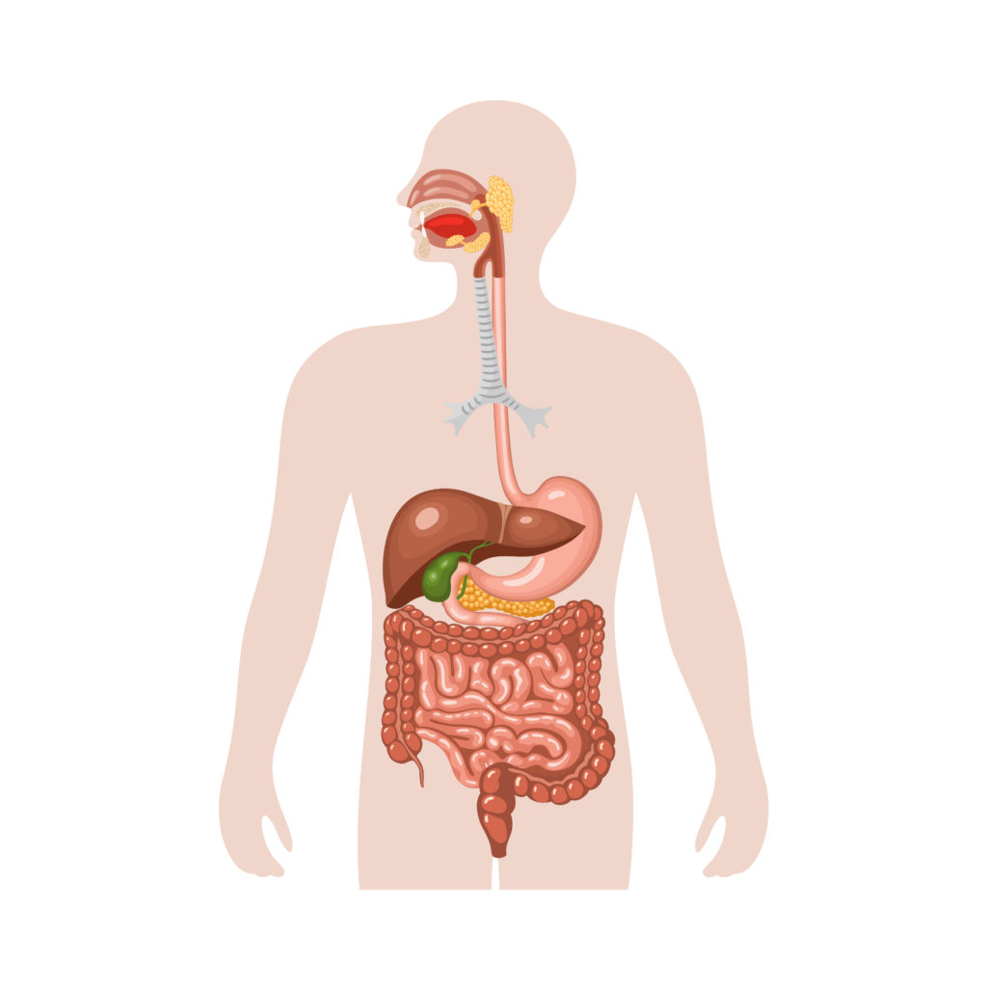
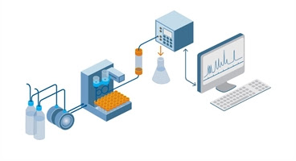


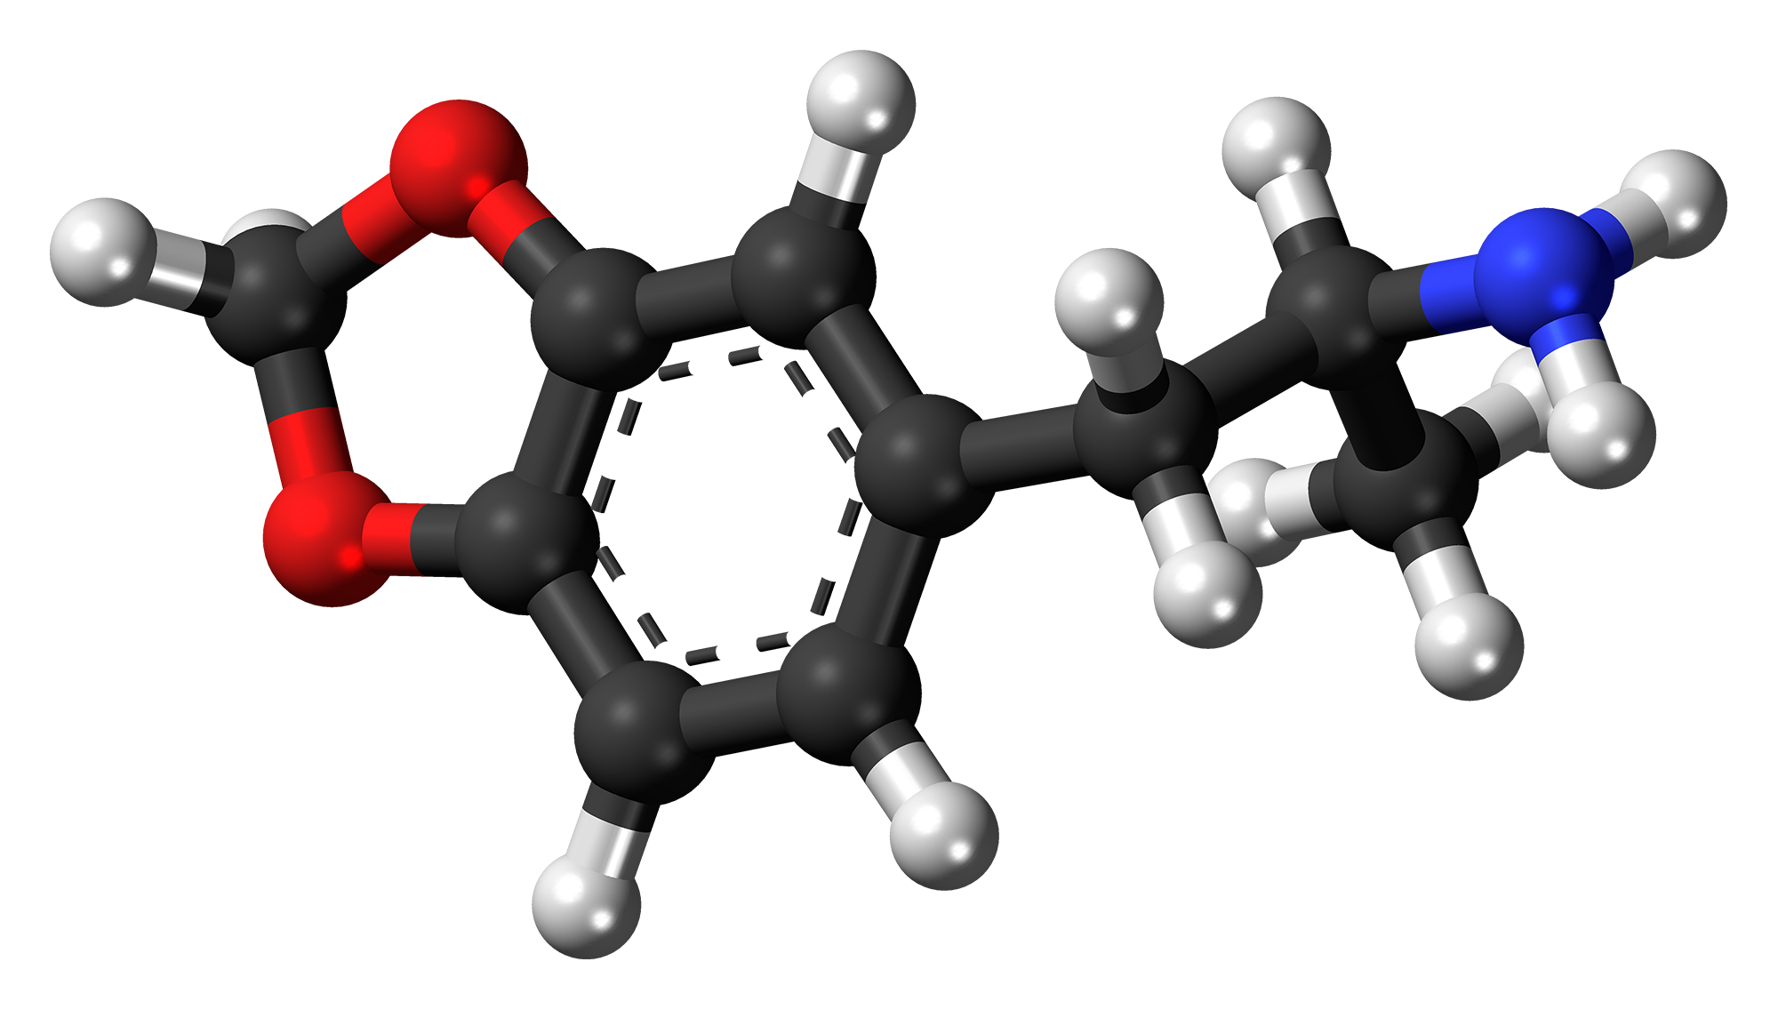
Wastewater Analysis Methods
Notes:
Scientist sample the unprocessed sewer water as if they were at a fancy wine tasting party, except they actually drink the samples instead of spitting them out. LMAO JK
^^ They actually sample the water with gold spoons and swish it around in their mouths like ice cream tasters :) - wonderful -
1. A given population consumes drugs, the drug identities, quantities, and frequency of consumption are unknown.
2. Individuals metabolize the substances and the waste products are excreted into the wastewater system.
3. Raw wastewater is collected at wastewater treatment facilities.
4. Samples are tested to determine the concentration of each target biomarker.
5. Flow rate is multiplied with substance concentration to obtain quantity of biomarker discharged per day.
6. Known human metabolic pathways for drugs of interest are calculated in reverse, beginning with the biomarker concentrations to arrive at an estimation for the quantity of parent compound consumed.
7. This number is divided by population estimates services by the water treatment facility to arrive at an estimation of consumption per day per 1,000 people.

Slide 7
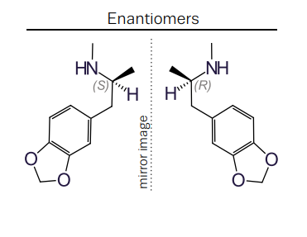
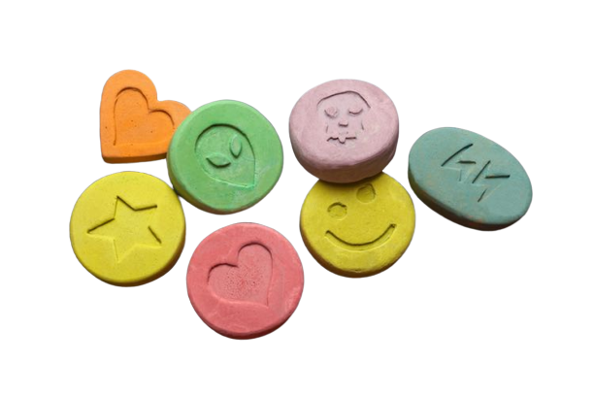
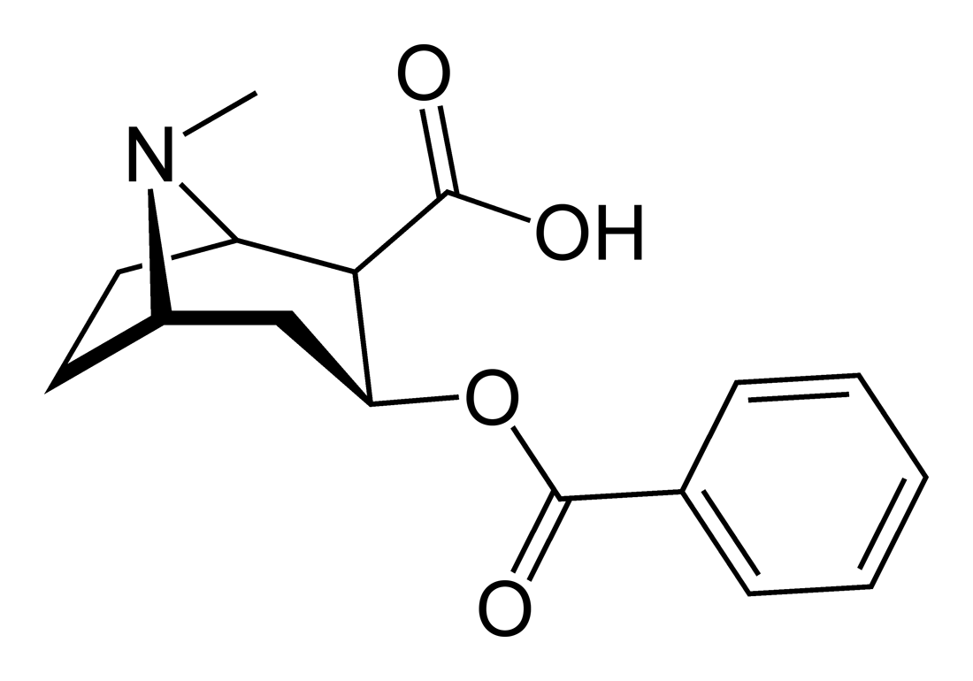
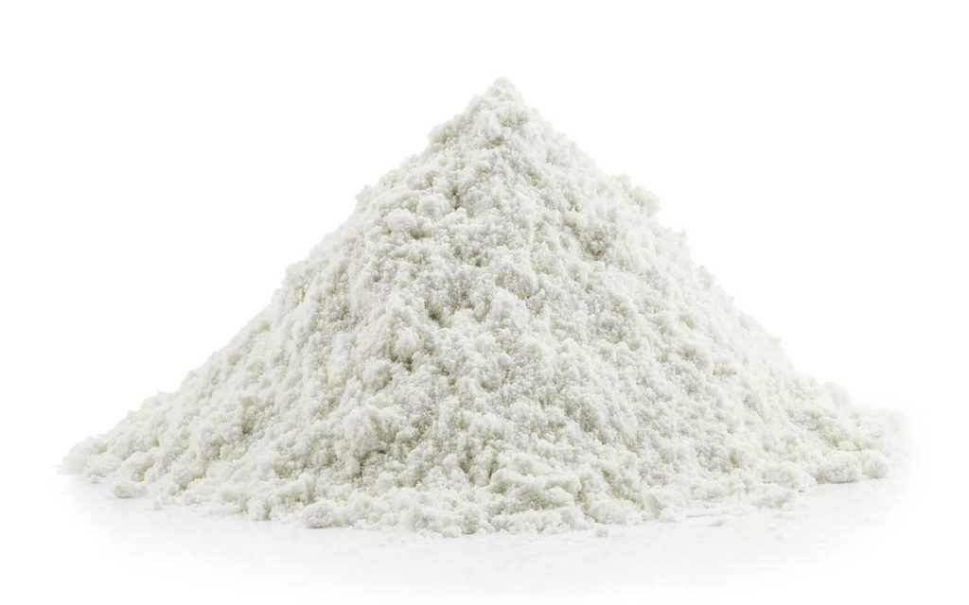
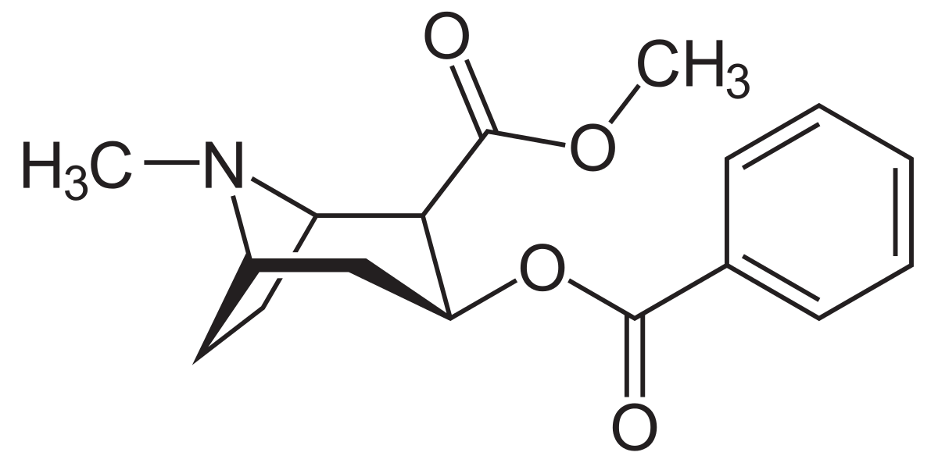
Consumption estimation method is substance dependent
S(+)-3,4-MDA
35%
R(-)-3,4-MDA
65%
MDMA
Benzoylecgonine
7
1
Cocaine
Cocaine
Notes:
-The back calculation step is the most nuanced in the process.
-Once the substance load in wastewater has been quantified, drug consumption estimations are produced by considering the known metabolic pathways for the drugs of interest.
-For example, MDMA is produced and consumed as a compound where both isomers of the compound are present in equal quantities (racemic).
-In the body, the two isomers exhibit different activity and are metabolized and excreted at different rates.
-The enantiomeric ratio of MDMA in urine is 65/35 with the R(-)-enantiomer dominating.
-Researchers use this ratio as the biomarker for the parent drug.
-Other substances will undergo more dramatic transformations during human metabolism.
-For example, benzoylecgonine, the main metabolite of cocaine is produced via hydrolysis in the liver.
-This functionally inert product is present in urine in a 7:1 ratio with cocaine.
-Researchers can then reliably deduce the quantities of the parent compound that would need to be consumed to produce the quantities of metabolites measured.
-Since metabolism is complex process with several steps, genetic variations will result in individuals who metabolize substances differently, leading to metabolite excretion that departs from the mean.
-The assumption for the back calculation uses the average metabolism for a human as the standard metric. While this could be an issue for deducing drug consumption for an individual, a given population will average to the standard metabolic pathways outlined in pharmacological literature. Therefore, these estimations are appropriate when generalized to a large enough group.

Slide 8

Ethical Statement
https://score-cost.eu/about-us/
In 2016, Sewage Analysis COre group Europe (SCORE) published ethical guidelines for waste-water based epidemiology. The objective of these guidelines is to outline the main potential ethical risks for WBE research and to propose strategies to mitigate those risks
Sample guidelines:
1. Sample size must be 10% of the total population or contain measurements from at least five locations.
2. Respect individual privacy and community images
3. Choose partners with appropriate intentions
Our considerations:
1. We narrowed down our dataset to include 8 countries with >5 municipalities (15% of Europe)
2. Our potential covariates of interest do not target specific communities
3. This study only seeks to educate our peers
Notes:
The EMCDDA advises several considerations for using the data from their study
.1. For a country to be adequately represented by its cities, the sample size must be 10% of the total population or contain measurements from at least five locations.
2. Studies should take care not to mischaracterize certain demographics, particularly marginalized communities.
3. Partnerships developed with firms interested in employing research findings should be well vetted. It is the primary mission of the EMCDDA to serve the interest of public health, research conducted using their data should be instrumental in the improvement of public welfare
-In acknowledgement of these considerations, the countries selected for our study were Spain, Sweden, Switzerland, Belgium, Finland, Austria, Germany, and Slovenia.
-These countries collectively represent more than 15% of Europe’s total population, and each have data for at least five municipalities.
-Our investigation aims to examine relationships between illicit drug consumption and the broad demographic factors of age and GDP.
-These factors are not inclined to reveal any controversial relationships between the population and its drug use.
-Instead, this investigation aims to service these communities by reducing uncertainty surrounding drug consumption in the pursuit of optimizing public health.
-Our research involves no external collaborations or partnerships and is only intended to educate peers on drug use and its factors.

Slide 9



Objectives:
To examine how drug usage differs between European countries
To quantify the effect of the relative number of youth (aged 15-24) represented by the population of a country on the above relationship
To quantify the effect of the relative wealth of a country (GDP, USD 2011 currency) on the relationship stated in objective 1
We hypothesize that the effect of country on drug usage is dependant on the GDP and Age of each country.
We predict that:
Countries with a lower mean age and GDP will exhibit higher rates methamphetamine, amphetamine, and MDMA usage
Countries with a higher mean age and GDP will exhibit higher rates of cocaine usage

Slide 10



Age Data
Census data
Official estimates
Population registers
https://population.un.org/wpp/Download/Standard/Interpolated/
This data was collected for 235 Countries/Territories from 1950-2020
Austria, Belgium, Finland, Germany, Sweden, Switzerland, Spain, Slovenia
Population information
Percentage of population aged 15-24
Data from 2011-2020
Notes:
-The EMCDDA defines “youth” as individuals ages 15 - 24, which is the definition we used for our study
-Youth was a demographic of interest because it represents the age range where individuals are most likely to try drugs
-It is understood that initial substance use is not likely to occur beyond a person’s mid twenties…
-Additionally, non-problematic substance use developed during youth is unlikely to continue into a person’s thirties
-Public health investigations revealed that youth are more prone to substance abuse than adults when dealing with psychological distress
-Factors that highly correlate with problematic substance use in youth are: struggles with sexual identity, untreated psychiatric disorders, and current or past abuse
-Thus, youth represent a critically vulnerable population.
-Since drug use is prerequisite for problematic drug abuse, understanding the baseline consumption for a population can help predict the pool of individuals at a higher risk.
-Timely inventories of a population’s age distribution and drug use may therefore be useful in appraising the wellbeing of vulnerable demographics.
-Should predictive or descriptive models generated from these data prove reliable, public health action could be better informed for addressing matters of social welfare.
-We sourced our data for age demographics from the UN- department of economic and social affairs
-The United Nations curates large data repositories with detailed statistics on every country.
-Their website provides open source interfacing with statistical summaries
-The data can be queried by several factors and exported as a csv
-Through this interface, we were able to query a search for the populations of our selected countries for the years of interest
-The output provided each countries population as well as the percent each age contributed to the population for each year

Slide 11





Collected from 266 Countries/Territories between 1960-2020
GDP: the monetary value of all finished goods and services made within a country during a specific period.
Financial Data
https://data.worldbank.org/indicator/NY.GDP.MKTP.CD
National accounts data
Local currency
Constant price
2010
$USD
PPP surveys
Data from 2011-2020
Population Census
Agricultural Census
Income
surveys
Household surveys
AT
BE
DE
FL
SL
SW
SI
SP
Notes:
-Drug consumption represents a nuanced set of behaviors and is influenced by a variety of factors.
-For example, studies of European populations show an overall increase in alcohol consumption with increasing economic health
-However, problematic consumption of alcohol (problematic defined as more than two drinks per day, drinking outside of social context, and/or drinking for emotional quiescence) increased as economic health decreased
-While there exists variation in the consumption of illicit substances, there is a negative correlation between illicit drug abuse and economic wellbeing; as economic prospects worsen, drug abuse increases
-The magnitude and latency of response however, remains unclear as reliable methods of assessing these parameters have historically been difficult to track
-While GDP is often referenced in describing a country’s standard of living, it is not a fair metric for overall well-being
-However, due to the previously observed correlation between GDP and drug abuse, we posit GDP as a potential factor for assessing a populations inclination for drug consumption.
-Given the public health risk of substance abuse, we believe it important probe into the relationship between economic markers and illicit drug use.
-Should a clear pattern be revealed, it could provide public health outlets with a non-invasive and easily observed indicator for drug use
-For this reason, we have chosen to compare drug use with GDP through time for each locality of interest
-Similar to the UN, World Bank data represents an international collaborative effort to characterize global statistics
-Their data differs in that it is concerned specifically with economic indicators
-From the world bank repository, GDP data were selected for each country for each year of interest
-All data were prescaled into US currency and adjusted for inflation to the current year

Slide 12


Time to code!
Expectation
Reality

Slide 13

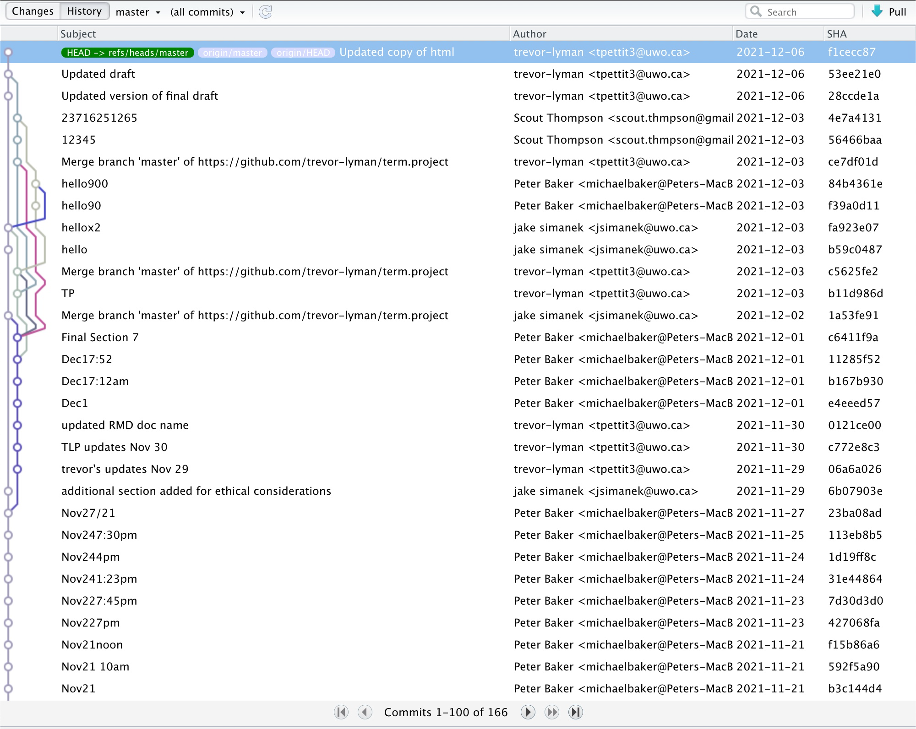
Like Google Docs for R!

Slide 14



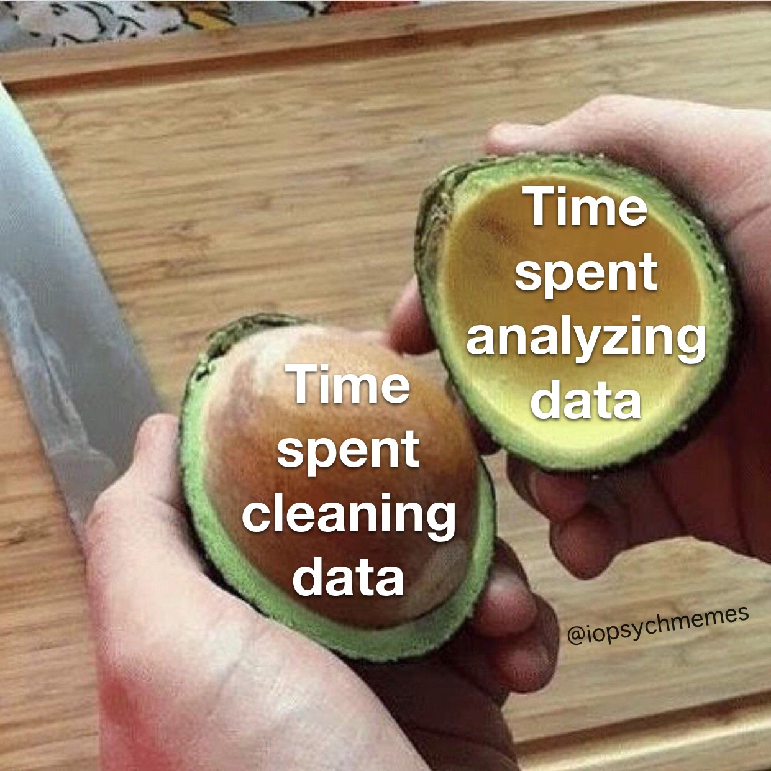
Data Tidying
GitHub:
https://bit.ly/3luicm8

Slide 15

Data Exploration
Age Data
Drug Data
GDP Data
Notes:
How did we conduct the preliminary exploration of our data

Slide 16
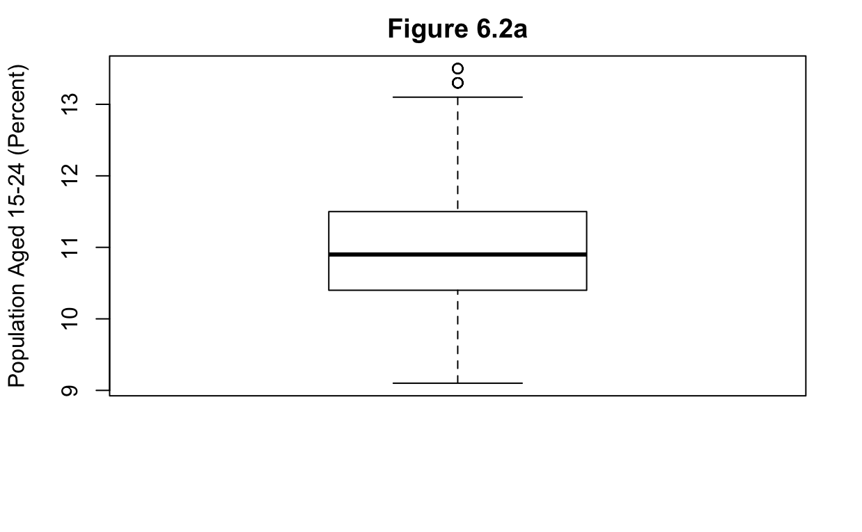
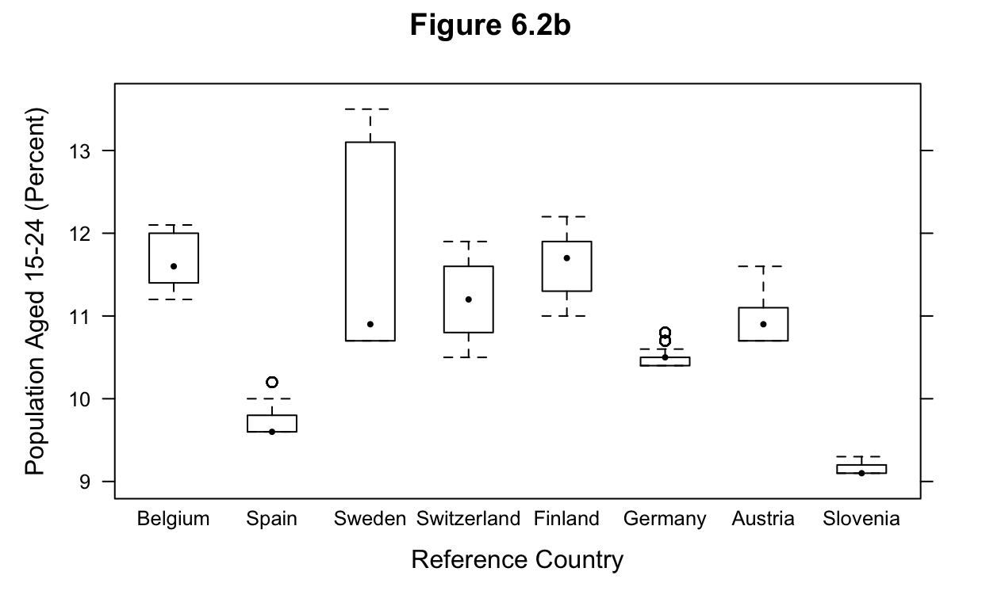
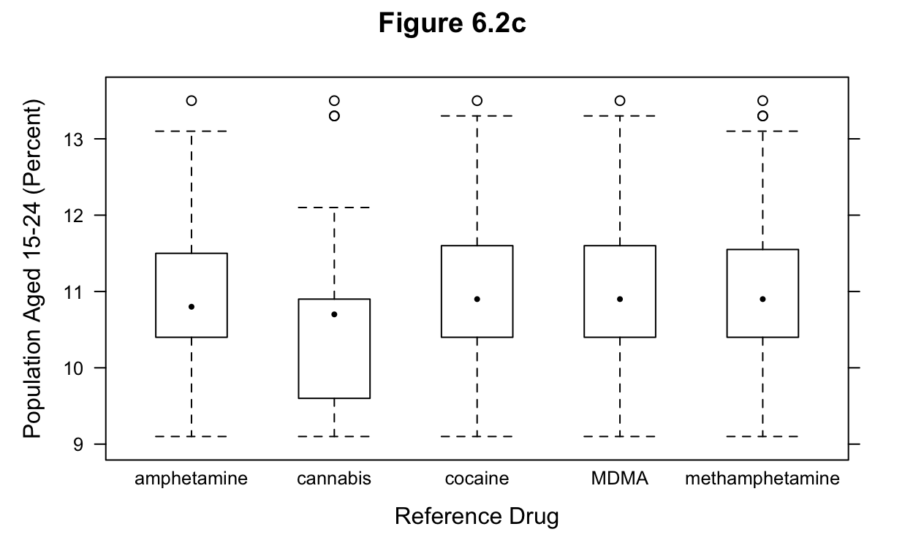
Age

Slide 17
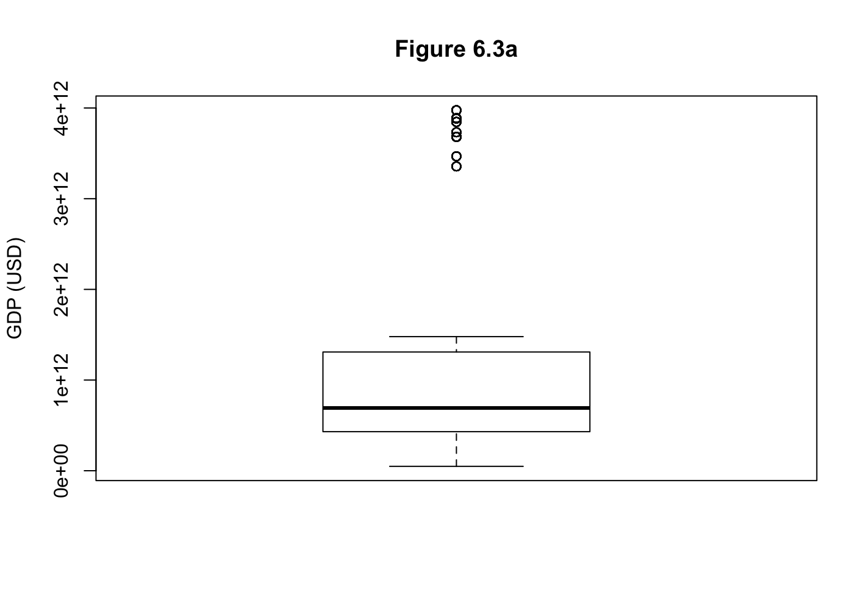
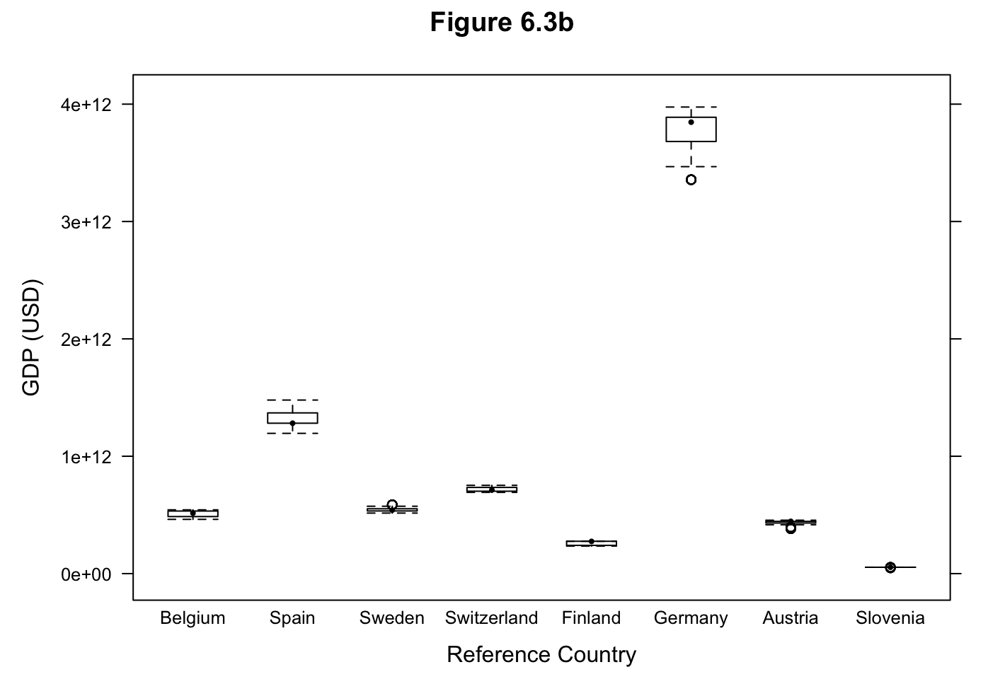
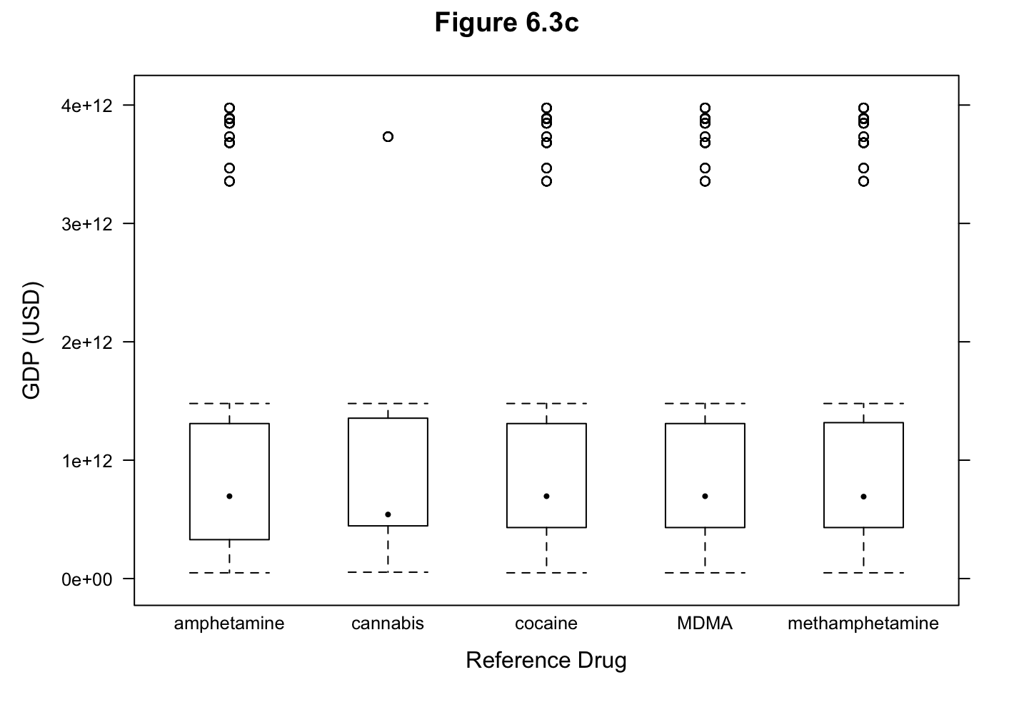
GDP

Slide 18
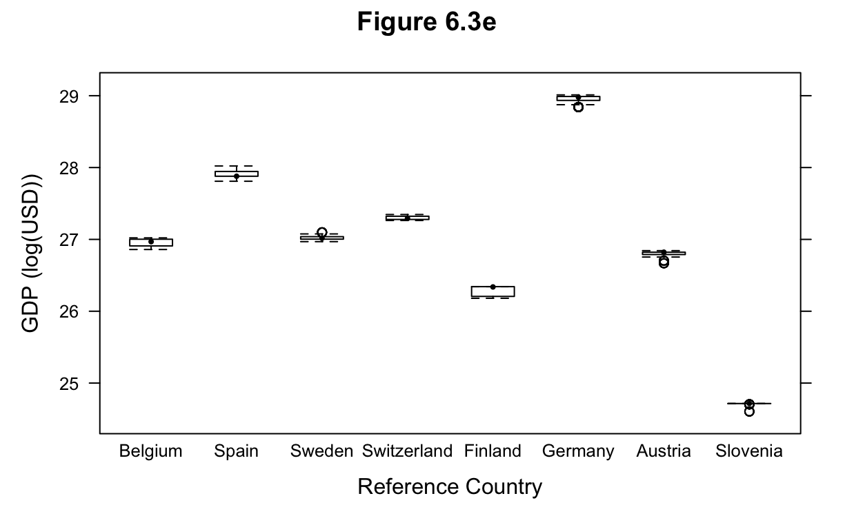
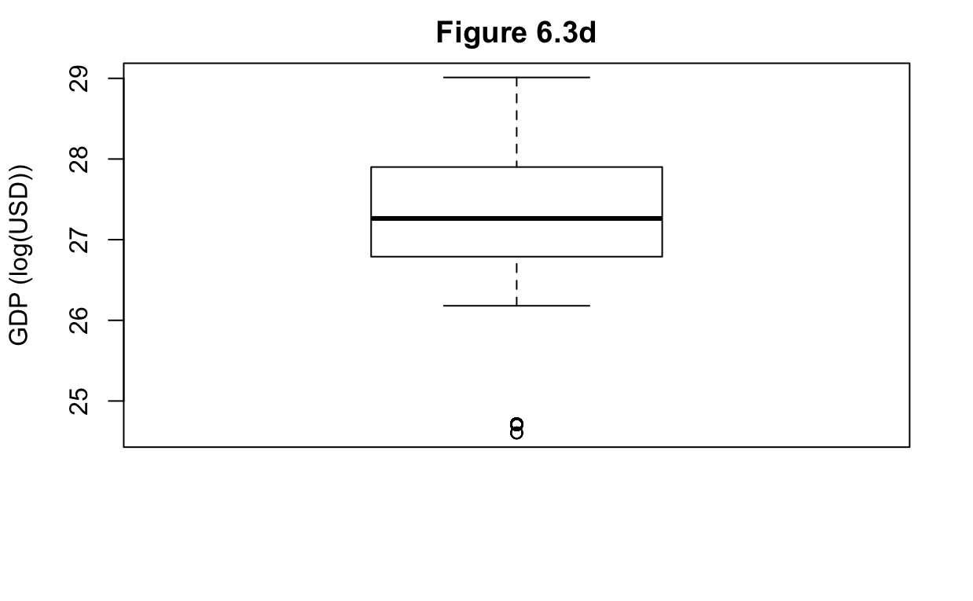
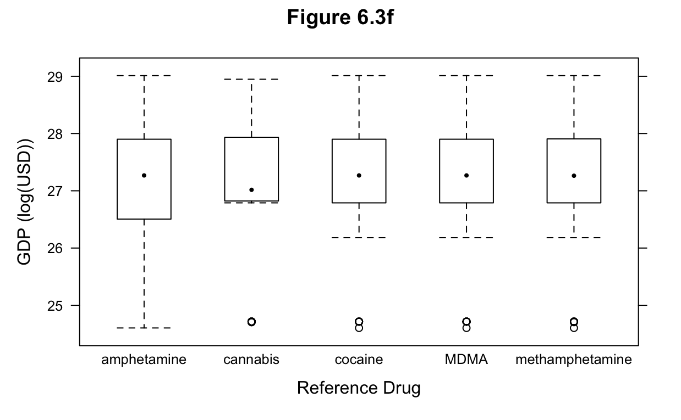
Log-transformed GDP
Log-transformed GDP = log(GDP)

Slide 19
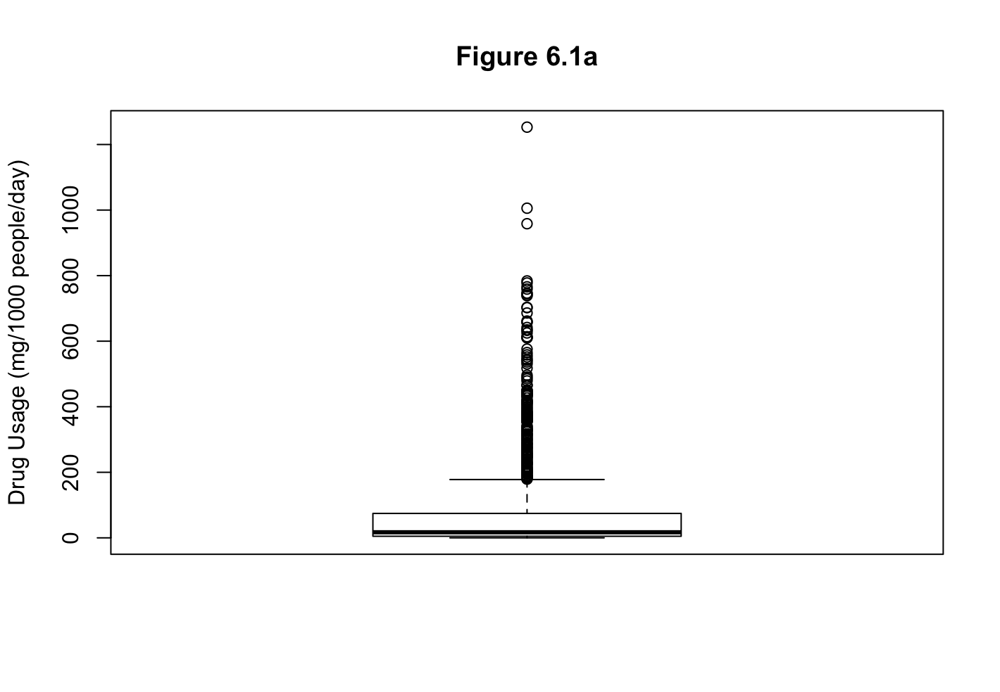
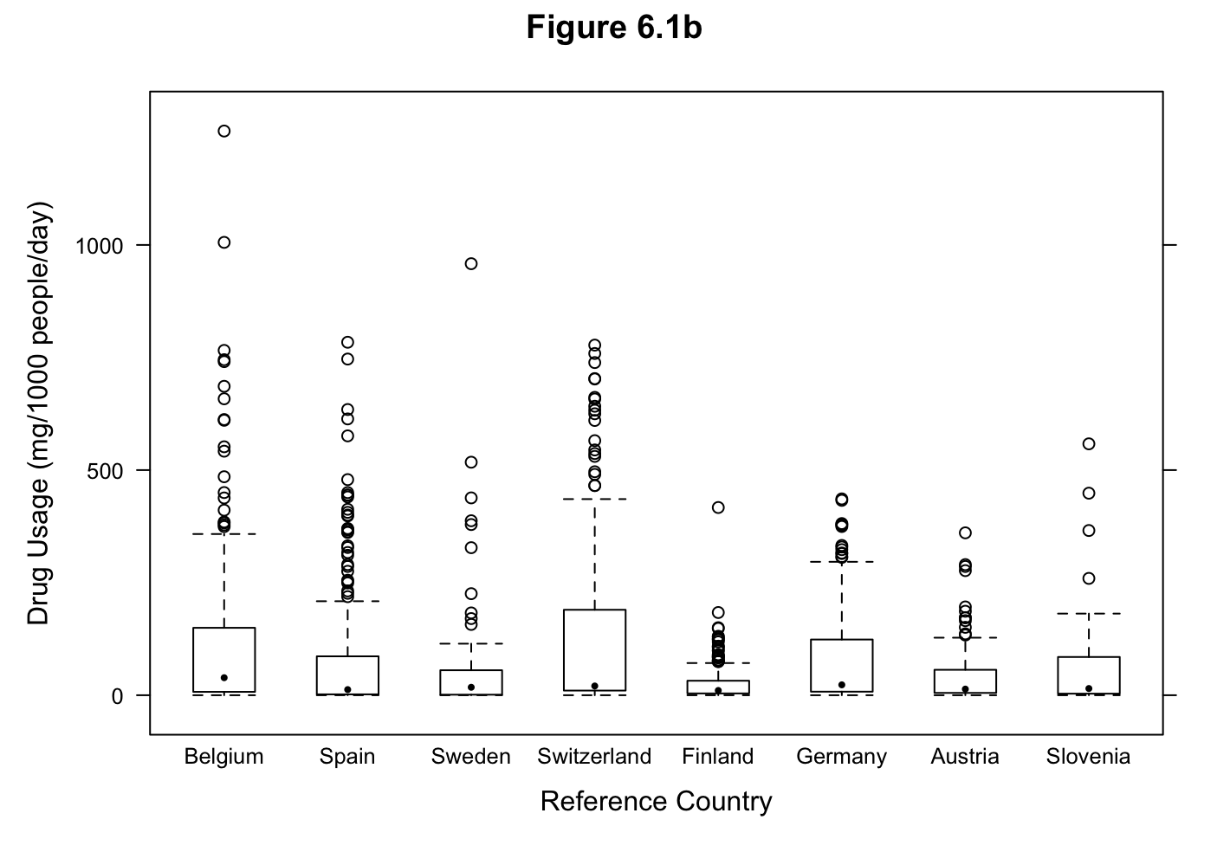
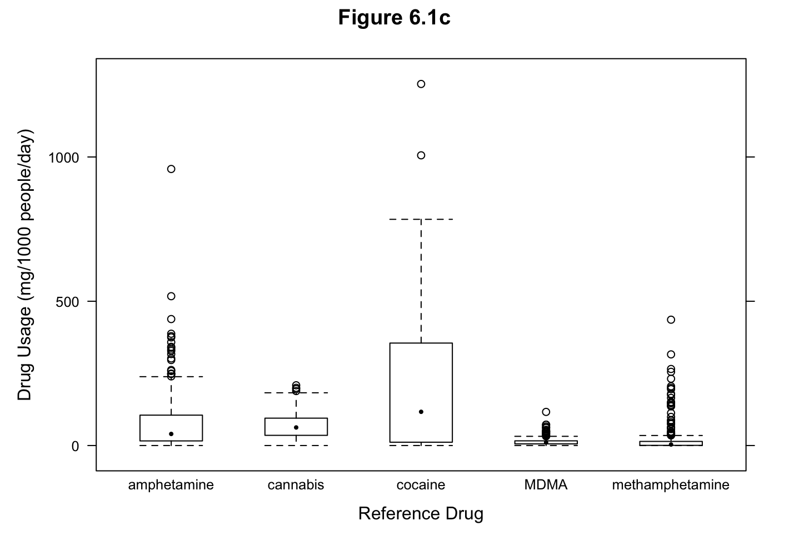
Drug Usage

Slide 20
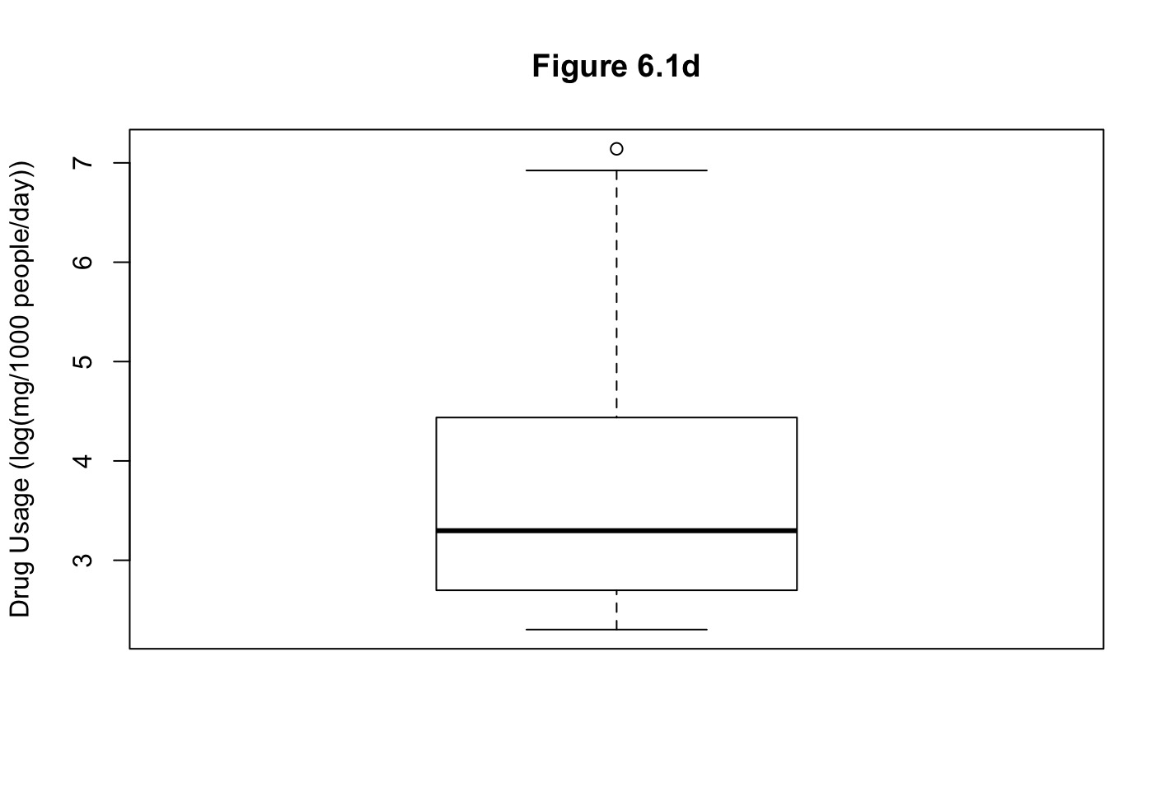
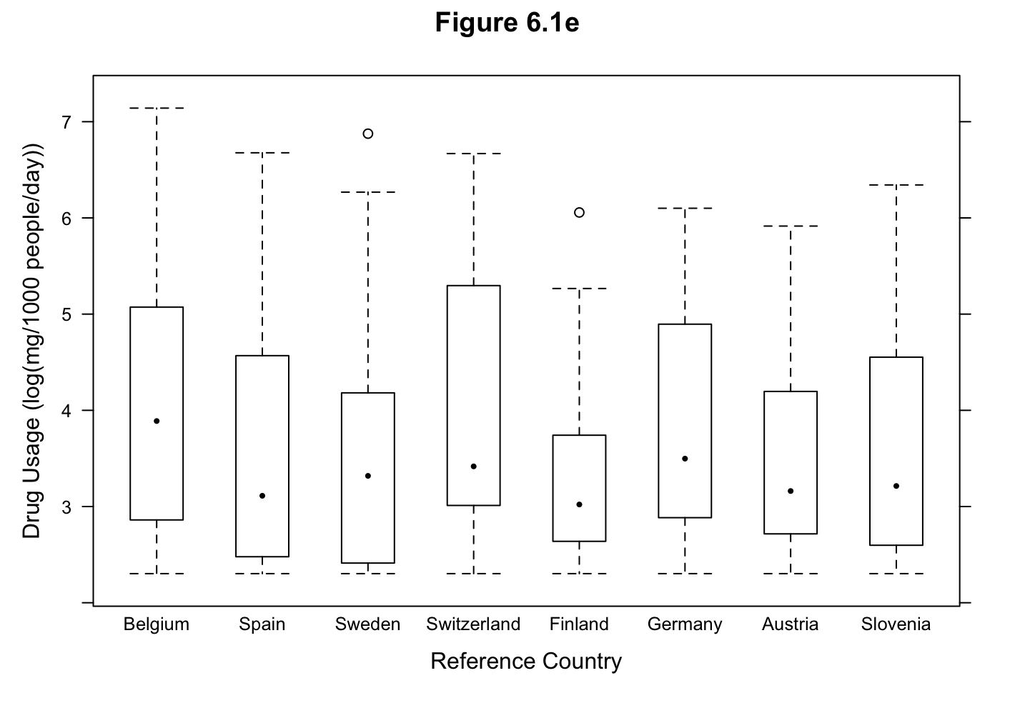
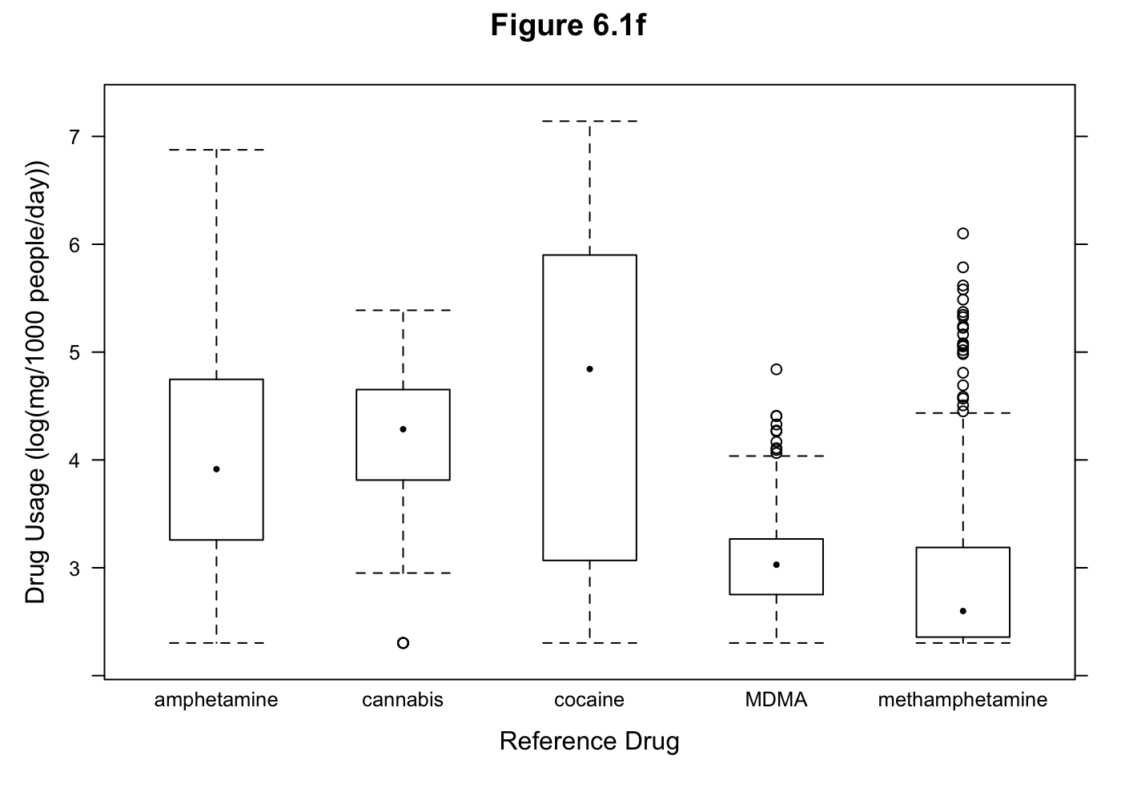
Log-transformed Drug Usage
Log-transformed Usage = log(10 + (Drug Usage))
Notes:
-note on flushing

Slide 21
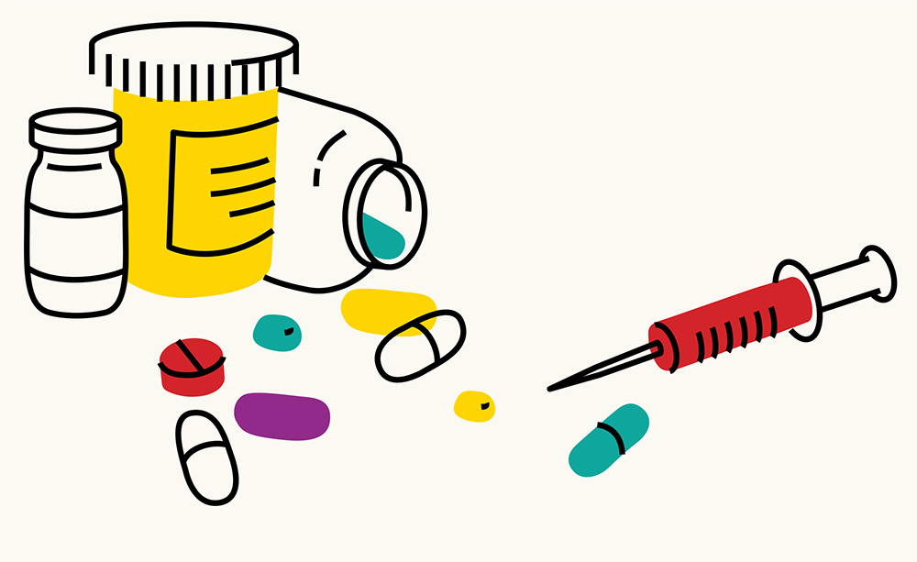
Drug Metabolite Analyses

Slide 22
Cocaine
Notes:
Transition slide

Slide 23
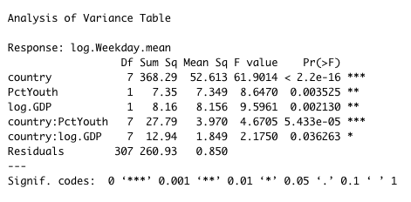
Model and ANOVA Table
Model: lm(data = cocaineplot, log.Weekday.mean ~ country + PctYouth + log.GDP + country:PctYouth + country:log.GDP)
Notes:
Hypothesis supported

Slide 24
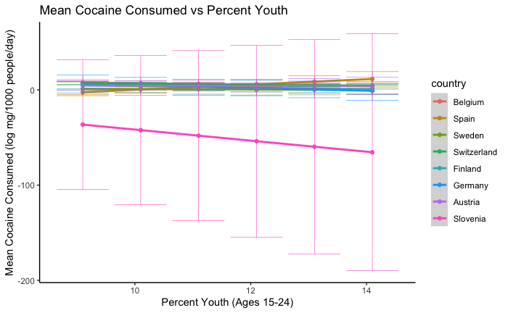
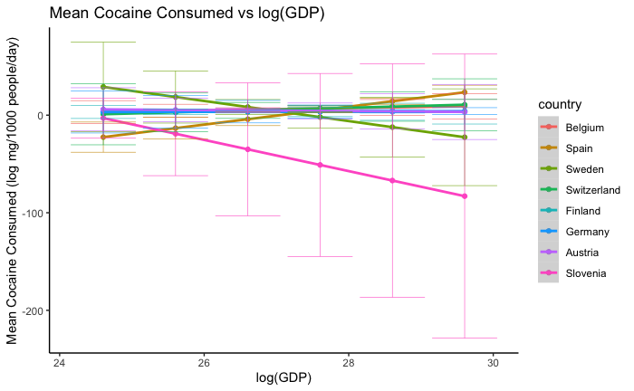
Plots

Slide 25
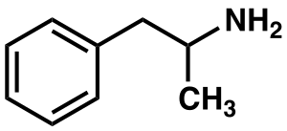
Amphetamine

Slide 26
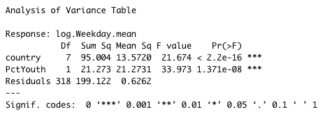
Model and ANOVA Table
Model: lm(data = amphetplot, log.Weekday.mean ~ country + PctYouth)
Notes:
Hypothesis not supported

Slide 27
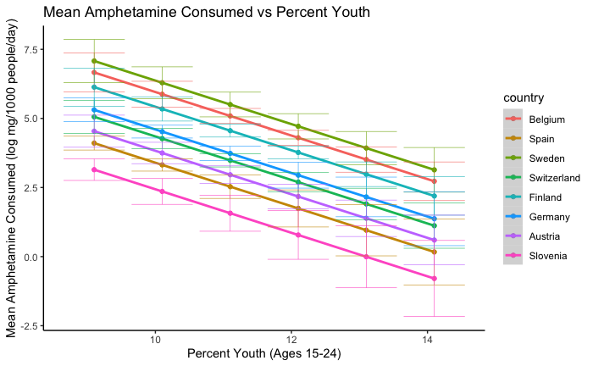
Plot

Slide 28
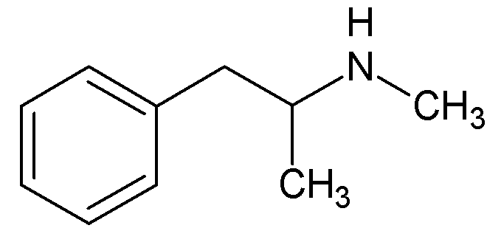
Methamphetamine

Slide 29
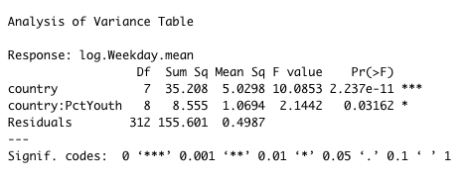
Model and ANOVA Table
Model: lm(data = methplot, log.Weekday.mean ~ country + country:PctYouth)

Slide 30
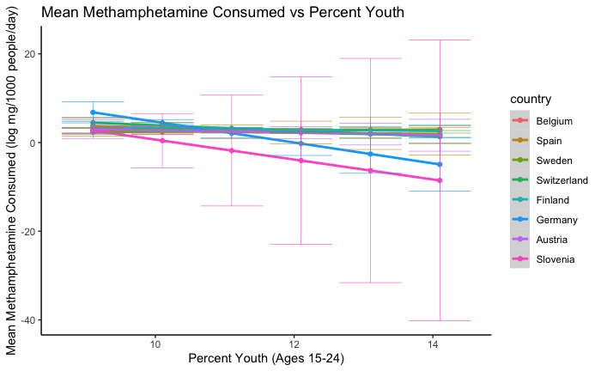
Plot
Notes:
-meth consumption declines with increased percent youth for slovenia because only their toddlers use meth. “Meth is for babies” - Slovenia

Slide 31
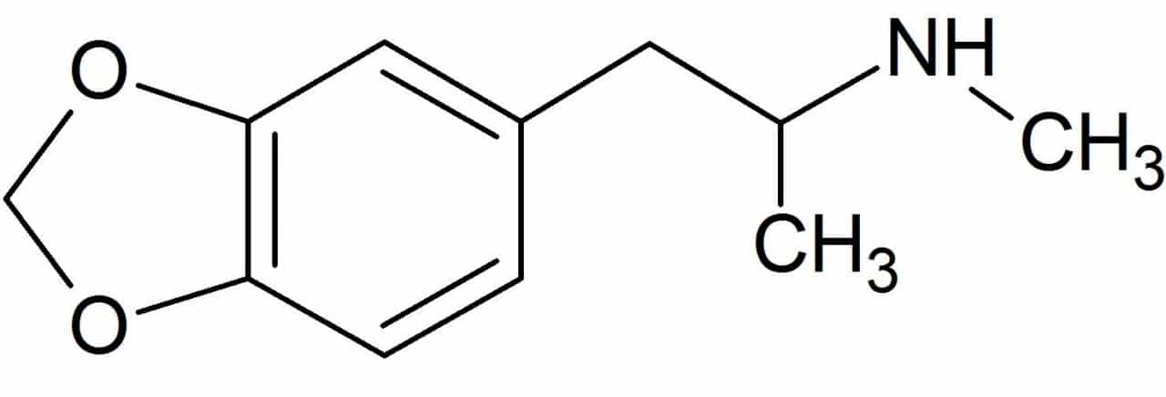
MDMA

Slide 32
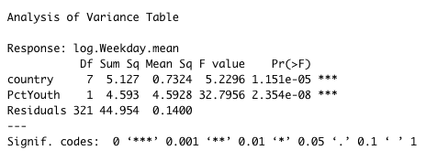
Model and ANOVA Table
Model: lm(data = MDMAplot, log.Weekday.mean ~ country + PctYouth)

Slide 33
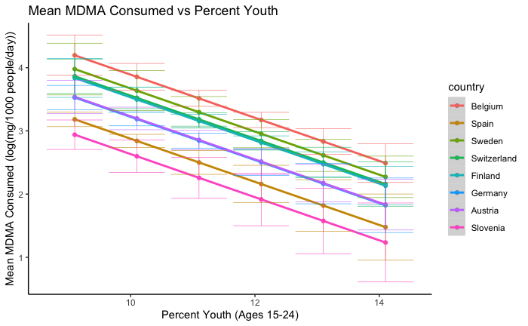
Plot

Slide 34
Summary
 | Amphetamines | Cocaine | MDMA | Methamphetamine
Drug usage varies by reference country? | ✓ | ✓ | ✓ | ✓
Relationship between percent youth and drug usage? | ↓ | ✓ | ↓ | --
Relationship between GDP and drug usage ? | -- | ✓ | -- | --
Interaction effects? |  | ✓ |  | ½ ✓
Hypothesis supported? |  | ✓ |  | ½ ✓
Notes:
-Trevor

Slide 35



Harm reduction is a public health approach that saves lives by minimizing harm and potential danger.
Addiction is
a moral issue
Addiction is
a health issue
Jailing addicts
Supervised consumption
& injection sites
Criminalizing possession and use
Access to sterile needles and drug checking
People who OD deserve it
Free naloxone
No knowledge = no usage
Preventative
Outreach programs
Knowing the issues allows for resource distribution and preventative policy making
“They did this to themselves”
Community and peer support
https://harmreduction.org/about-us/principles-of-harm-reduction/
Notes:
Harm reduction is the best way to tackle addiction!
By using drug usage data collected from wastewater analysis, we can get a better idea of how and which drugs are affecting a community
This allows for the distribution of resources, and the creation of policies to allow for a harm reduction model of tackling drug addiction (which is better supported by science) than the traditional method of leaving it to law enforcement (oink oink)

Slide 36

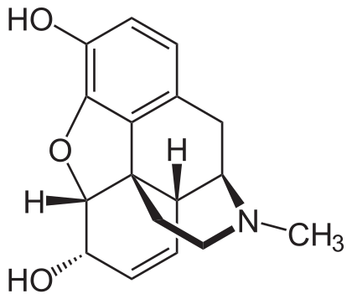
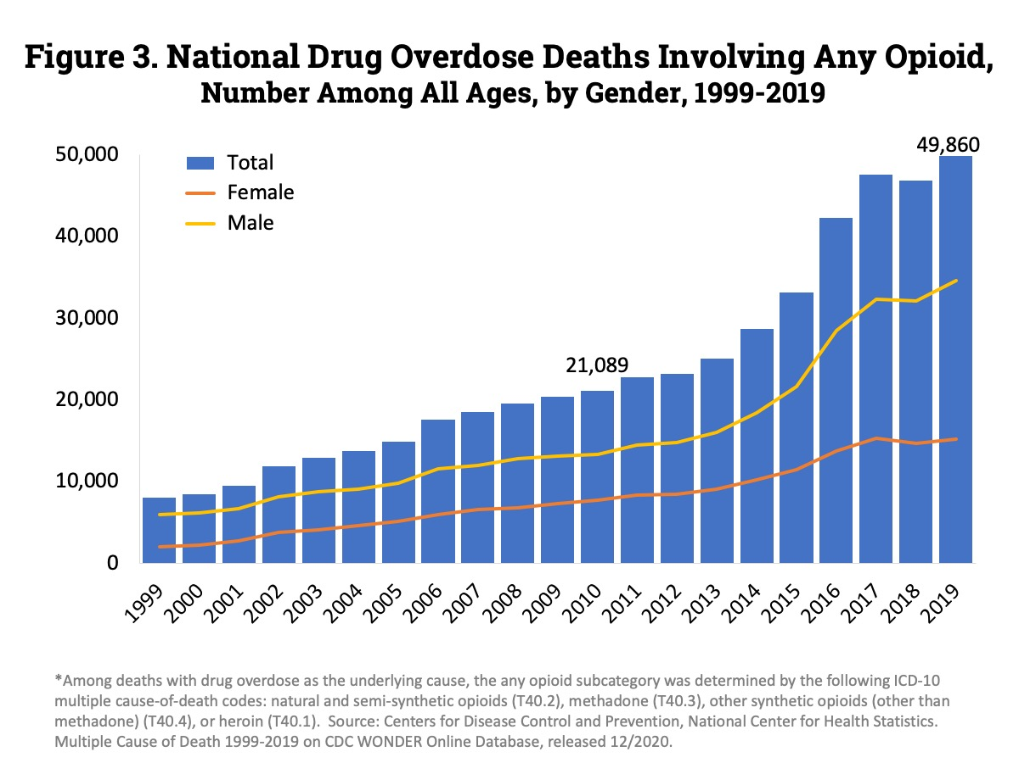
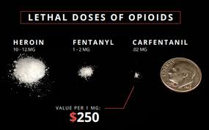
Opioid Overdose Epidemic
Papaver somniferum
(opium poppy)
https://www.drugabuse.gov/drug-topics/trends-statistics/overdose-death-rates
Photo from Missouri River Drug Task Force
Notes:
-The rise in overdose deaths related to opiates has been a fixture in national news since the early 2000’s
-Opium and Codeine are naturally occurring compounds produced by the opium poppy (Papaver Somniferum)
-these compounds alleviate pain but can be deadly in high doses by reducing respiratory activity
-partially synthetic derivatives and fully synthetic analogs of these compounds are within the class of drugs known as opioids
-some of these drugs are extremely potent in small quantities, fentanyl is 100x the potency of morphine and carfentanil is 10,000x the potency of morphine
-overdose deaths in canada have been increasing since the early 2000’s, with a 30% increase from 2016 to 2017 alone
-part of this has been attributed to the increasing prevalence of potent opioid analogs
-users used to a certain dose can very easily find themselves overpowered if the product is adulterated with a potent analog
-whats more, other drugs are at risk for cross contamination
-drugs that are processed, weighed, and packaged with the same equipment by the same individuals, can come into contact with these compounds
-and unnoticable quantities introduced to one substance could easily be enough to produce an effect
-weather someone consumes opioids intentionally or unintentionally, it is important to recognize signs of danger

Slide 37


Did you know that fentanyl may be used to cut drugs? Even those that are typically considered harmless?
Do you know the signs of an overdose?
Notes:
Talking about the signs of an overdose, information on fentanyl contamination in common drugs (* note from Scout: just keep in mind here to not provide TOO graphic of a description/not push people too hard to answer - some people in the class may have had difficult experiences with this)
Naloxone and how to use it/where it can be acquired (Demonstration needs to be of the nasal spray kind, it would be extremely inadvisable to suggest people inject needles without proper training - however, proper training on this method is offered by the health unit… might be useful to see if there is a difference in effectiveness between the two methods)

Slide 38


NARCAN® Nasal Spray, the first nasal formulation of naloxone to be FDA approved for the treatment of known or suspected opioid overdose. Designed for use in the community, NARCAN® Nasal Spray is needle-free and ready to use.
https://www.narcan.com/
Notes:
Step 7: draw on their face with sharpie, tell them the paramedics did it
-Narcan (naloxon) kits are free and available at any pharmacy
-It's better to have it and not need it than to need it and not have it

Slide 39

+ First Aid +
-CPR is available through the campus rec center once per semester
-Online trainings are also given by the Canadian Red Cross
-Recovery position

